Slide 1
MongoDB vs SQL: A Comparative Analysis
Understanding the Differences in NoSQL and SQL Databases Bilel Benltaeif

Slide 2
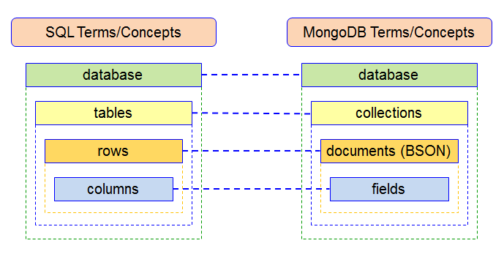
Data Model
MongoDB:
Document-based storage
BSON (Binary JSON) format
Flexible schema
SQL:
Table-based storage
Structured schema with predefined schema
ACID compliance

Slide 3
Query Language
MongoDB:
JSON-like queries
Supports rich queries with nested documents
Utilizes the MongoDB Query Language (MQL)
SQL:
Standardized SQL queries
JOIN operations for complex queries
Structured Query Language (SQL)

Slide 4
Scalability and Performance
MongoDB:
Horizontal scaling with sharding
Designed for distributed and large-scale applications
Suitable for handling unstructured and semi-structured data
SQL:
Vertical scaling with more powerful hardware
Better for complex queries and transactions
Suitable for structured and normalized data

Slide 5
Use Cases and Conclusion
MongoDB:
Ideal for projects with evolving requirements
Well-suited for large-scale applications with diverse data types
SQL:
Suitable for projects with a fixed schema and well-defined structure
Preferred for transactional applications, financial systems, and traditional relational database use cases
Conclusion: Emphasize the importance of choosing the right database based on project requirements.

